Slide 1



Feed Efficiency and Understanding its Impact on Production Systems
Daryl Strohbehn, Ph.D.
Emeritus Professor
Iowa State University
Bob Weaber, Ph.D.
Ext. Cow-Calf Specialist
Kansas State University

Slide 2
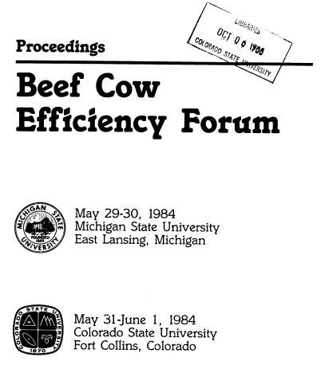
Approaching the 30th anniversary of a very important conference:
The CSU and MSU
“Beef Cow Efficiency Forum”

Slide 3
“Ultimate objective was to identify potential means for improving beef production efficiency, particularly in the cow-calf segment.”
--Dr. H.D. Ritchie, MSU

Slide 4
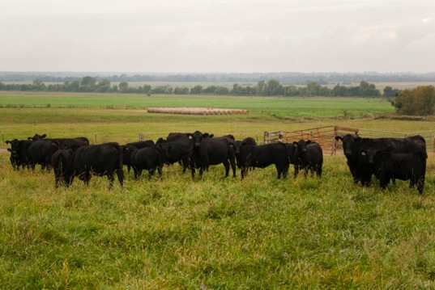
Our questions to you are:
Have we accomplished any improvements in efficiency in the 28 years since that conference?
Has our thought process approached that topic with our customers economic future in mind?

Slide 5
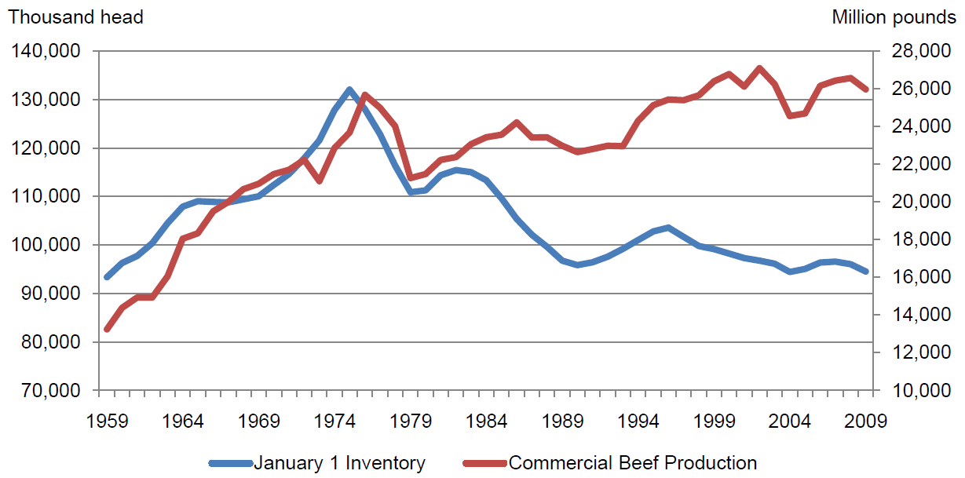
January 1 US Cattle Inventory and Commercial Beef Production
USDA-NASS, 2010

Slide 6
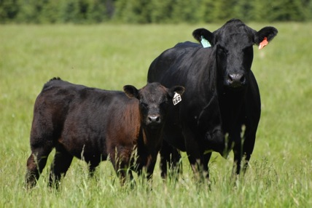
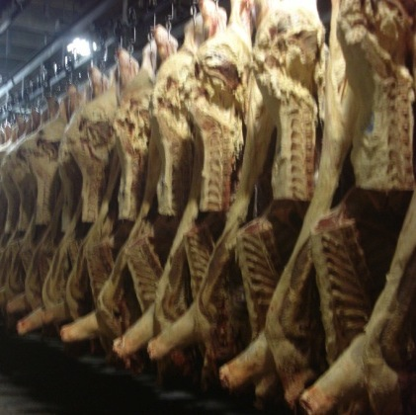
Granted:
Along the way we have had to address some pressing issues, haven’t we?
  Calving ease
  Value-based marketing
  Product quality
  Retention of market share

Slide 7
How’s the beef production paradigm changed?

Slide 8
Situational Analysis
High input costs for:
  Feed
  Fertilizer
  Fuel
Producers asking more questions about efficiency of production
  Input:output questions
  Breeding systems
  Replacement selection
  System/management questions

Slide 9
Kinds of Efficiency
Feed Efficiency
  To some defined endpoint
Metabolic Efficiency
  Maintenance requirement
Production Efficiency
  Output at some endpoint given inputs to the point
Economic Efficiency
  Value of output given input costs

Slide 10
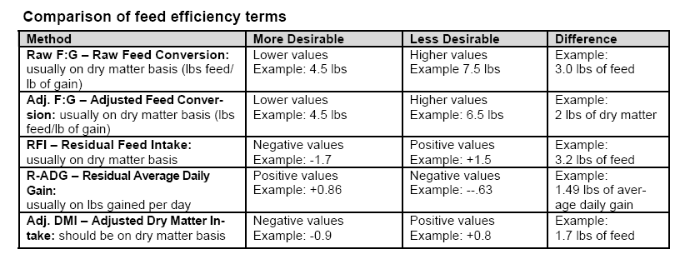
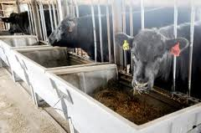
Measuring feed efficiency
Dahlke et al (www.iowabeefcenter.org/Docs_cows/IBC41.pdf)

Slide 11
Importance of Feed Efficiency
Feed costs = 66% in calf feeding systems
Feed costs = 77% in yearling finishing systems
  Anderson et al. 2005
10% improvement in gain = +18% profit
10% improvement in efficiency = +43% profit
  Fox et al. 2001
Efficiency increases have 7-8 times the economic impact of comparable increases in gain
  Okine et al. 2004

Slide 12
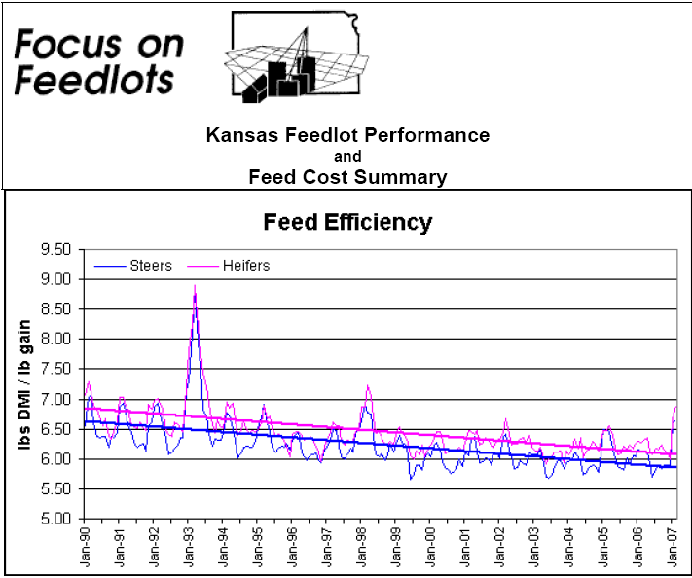
(Reinhardt, Waggoner, KSU)

Slide 13
And the conclusion from this close-out data is…

Slide 14
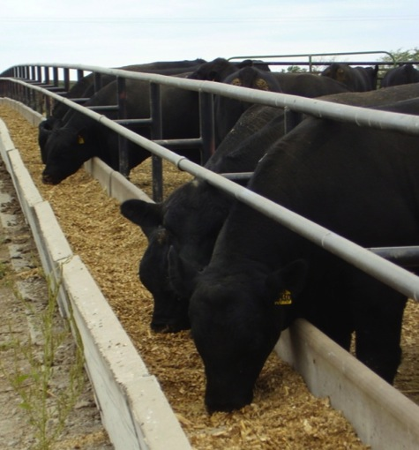
Conclusion—Feedlot Closeout data
The rate of improvement has slowed
The genetics of feed efficiency is a largely untapped source of improvement

Slide 15
Producer Progress in Feed Efficiency
Wardens Farm, IA
Last decade of selected bulls:
Average adjusted feed conversion:
4.99 lbs Dry Matter/lb of gain
Average Residual Feed Intake: -1.93

Slide 16
How much is a modest improvement in efficiency worth?

Slide 17
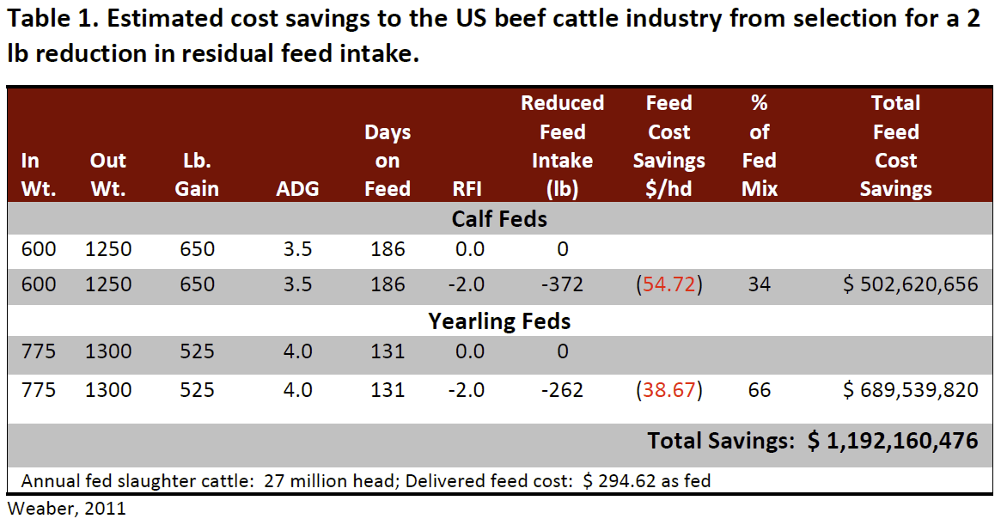
Value of Improved Efficiency in Feedlot Sector

Slide 18
Understanding the components of feed efficiency
More efficient cattle may have improved digestion or metabolism of nutrients, or
More efficient cattle may utilize absorbed nutrients more efficiently

Slide 19
Understanding the components of efficiency
Maintenance
  Genetic and environmental component
  Impacted by metabolic rate, cellular efficiency
Production
  Growth-impacted by body composition, nutrient partitioning
  Fetal growth, milk production, body condition change
Cow efficiency—reproduction, production

Slide 20
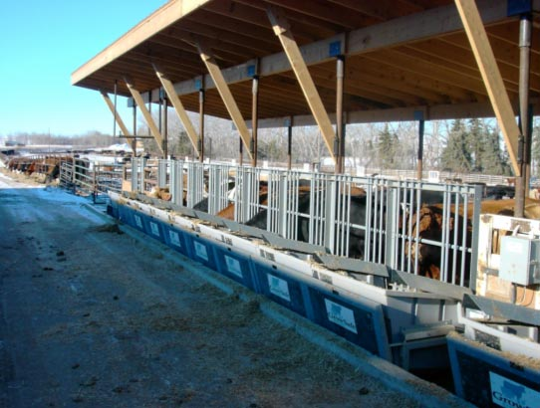
EPD for Efficiency and
Input Traits DO Exist
Residual Gain
Days to Finish
Feed Intake (unpublished but in index)
Maternally oriented
  ME
  $W
  $EN

Slide 21
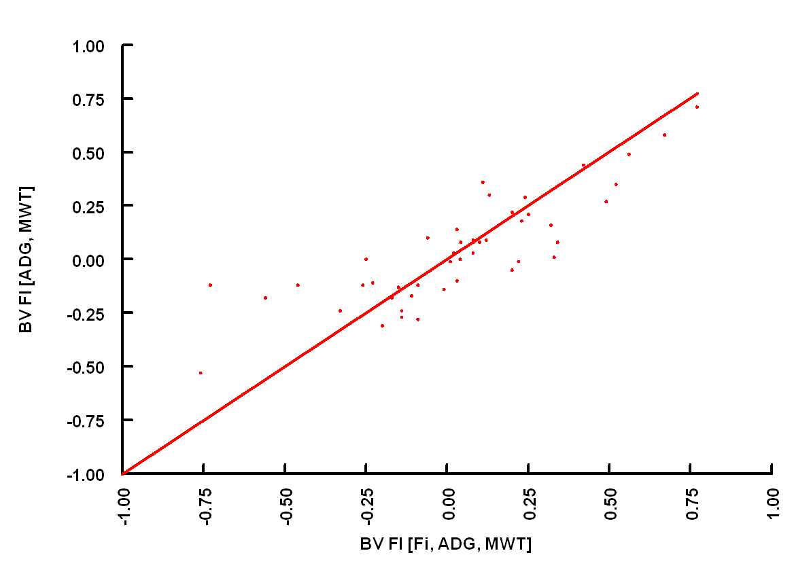
We can learn a lot about intake by looking at output!
r = 0.84
(MacNeil, 2012; ASA data)

Slide 22
What Role Does Genetics Play?
 | ADG | DMI | RFI | G:F
ADG | 0.26 | 0.56 | -0.15 | 0.31
DMI |  | 0.40 | 0.66 | -0.60
RFI |  |  | 0.52 | -0.92
G:F |  |  |  | 0.27
Phenotypically: intake drives gain
Goal is to break genetic relationship between ADG and DMI…just like we did with BW and YW!

Slide 23
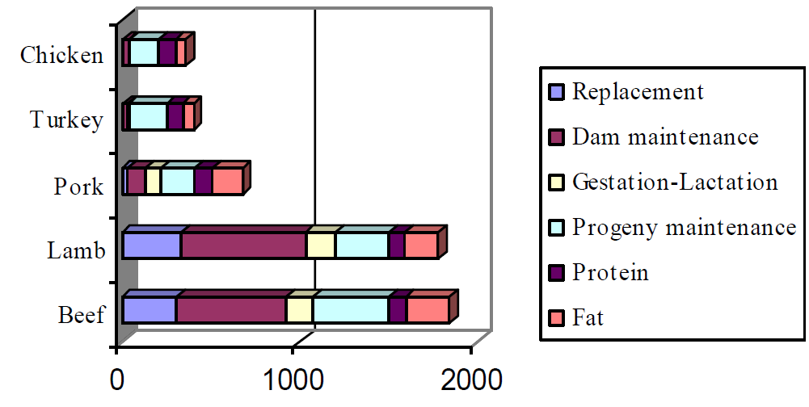
Life cycle energy intake/kg edible product
Efficiency of growth in cows is NOT the target
Maintenance requirement and efficiency are the target
Dickerson, 1978

Slide 24
What’s an efficient beef cow?

Slide 25
What’s the ideal beef cow?
Many definitions, but here are the musts:
  Has minimal maintenance requirements, but carries enough body condition to withstand feed shortages
  Produces enough milk to raise a good, healthy calf
  Gets pregnant → On Time, Every Time
  Has excellent maternal characteristics

Slide 26
From your customer’s perspective
An efficient cow is important….BUT
  They deal with the whole ranch or farm production system
  Production system is complex, multi-faceted & multi-trait oriented.
  Your JOB – supply breeding stock that will enhance the genetic part of that complex system.

Slide 27
Defining Feed Efficiency for Cow Herd
Lbs of calf weaned per cow exposed
  Conception rate, calving rate, calf survival, lactation, growth to weaning
Lbs. of calf weaned per cow exposed per unit energy consumed
    Conception rate, calving rate, calf survival, lactation, growth to weaning, energy (calories) consumed
Calf value ($) per $100 input cost
Much work to be done…
Notes:
Residual feed intake is calculated as the difference between observed and expected feed intake (), which is usually predicted from the regression of average daily feed intake (AFI) on ADG and metabolic midweight (MMW; mid-weight^{0.75})

Slide 28
Jenkins & Ferrell, 1994

Slide 29
Interpret Jenkins and Ferrell study into “Cowboy Terms”
Angus cows – 1179 lbs ate 8865 lbs feed dry matter
  At $80 / ton for hay = $398.93
  Like most traits this has variation. Their standard deviation was 1720 lbs of dry matter or $77.40, so roughly 2/3s of the cows were from $321.53 to $476.33
  Like most traits, our cattle would have intake comparison ratios from 75 to 125
    Range in cow feed cost would be from $299.20 to $498.66
Is this difference worth our time and investment???
What about our 1400 to 1600 lb cows?

Slide 30
What do other studies suggest?

Slide 31
Meyer, et al., 2008
Evidence that selection of replacements for efficiency can be beneficial.
Based on yearling development efficiency a comparison was done between Low 1/3 RFI vs. High 1/3 RFI Hereford females.
During mid to late gestation the higher efficient heifers consumed 21% less feed before calving
Following calving the higher efficient heifers and their calves consumed 11% less feed
There was no difference in cow body weight, cow body condition score or calf gain.

Slide 32
Crowley, et al., CSU: 2011
Using Irish Cattle Breeding Federation database
2605 bulls from one test station and records from 94,936 commercial females
Findings: Genetic correlations
  Feed conversion ratio and maternal weaning weight = -.61
  Residual ADG and maternal weaning weight = .57
  No correlations with fertility, calving difficulty or calf survival.
  But there was a genetic correlation with age at 1st calving

Slide 33
What are the folks down-under and up North finding?

Slide 34
Efficiency in Cows
In Australia, RFI in heifers had a 0.95 genetic correlation with RFI measured again when they were nearly mature (open) dams
  Both tests were drylot-based
  The main issue with a measure of efficiency in cows is as a correlated trait, preferably measured early in life
  Most selection on replacements and sires
Few studies have reported or predicted the effects of intake or efficiency selection on the total system
  Archer et al., 1999
  Crews, 2005
Basarab et al., 2007 reported on a retrospective study
  Their basic question was what could be said about the mothers of low RFI versus high RFI calves

Slide 35
Summary: Dams of High, Medium and Low RFI calves
Dams of low RFI calves
  Higher 10-yr average condition score
  Lost less backfat from calving to breeding
  Lower intake on forage
  Calved about 5 days later in season, but similar calving interval
Dams of high RFI calves
  Higher calf death loss
  Higher twinning rate
No difference among dams for other cow productivity traits
  Pregnancy, calving and weaning rates similar
  Calf weaning weights similar
  Various production and biological “efficiency” indexes were similar

Slide 36
What to do? What to do?
Change environment to fit the cows?
Change the cows to fit the environment?

Slide 37
Improve Efficiency of Feed Utilization or Match Nutrient Demand to Environment?
Gestation
&
Lactation
Gestation
&
Lactation
Cow 1
Maintenance
Cow 2
Maintenance

Slide 38
Reproducing Cowherd Efficiency
[Calf Weight*Calf Weight Value +
{Culling Rate * Cull Cow Weight*Cow Weight Value}]
- {Feed_{M}(cow) + Feed_{P}(cow) + Feed_{U}(cow)}*Cow Feed Value
- {Feed_{M}(calf) + Feed_{P}(calf) + Feed_{U}(calf)}*Calf Feed Value
- {Feed_{M}(heifer) + Feed_{P}(heifer) + Feed_{U}(heifer)}*Heifer Feed Value
(adapted from Dickerson, 1970)

Slide 39
Why a Genomic Approach?
The components of FE are heritable
The input side is expensive to measure
  FI can be more expensive than HD genotypes
Not feasible for routine phenotypes to enter NCE
Phenotypes are still need for discovery and validation
  Training is on adjusted phenotypes
  because no EPD exist

Slide 40
What Impact Can (will) Genomics Have?
Genomic information has the potential to increase accuracy
  Proportional to %GV
  Impacts inversely related to EPD accuracy
Multiple trait selection is critical and could become more cumbersome
  Economic indexes help alleviate this
  Use index values that meet your breeding objective

Slide 41
Our Charge to You:
Sustainability and profitability of the beef value chain requires better stewardship of our resources going forward
Selection for individual merit is important to you (seedstock)!
Herd level production efficiency is important to your customer!
Current selection tools are effective…you should use them now!
Use correlated trait data from across industry segments
Selection for all measures of efficiency should be applied in a multiple-trait context…always!

Slide 42
Thank You!
Questions?

